Slide 1
Medical care market performance –
Three articles
HSPM J712

Slide 2
Reinhardt, U.E., "Resource Allocation in Health Care: The Allocation of Lifestyles to Providers," The Milbank Quarterly, 1987, 65(2), pp. 153-176.

Slide 3
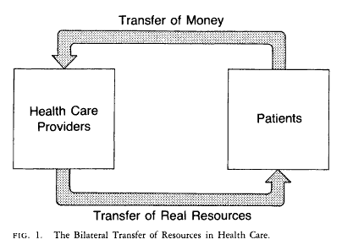

Slide 4
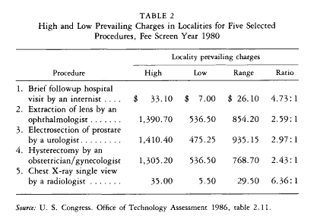

Slide 5
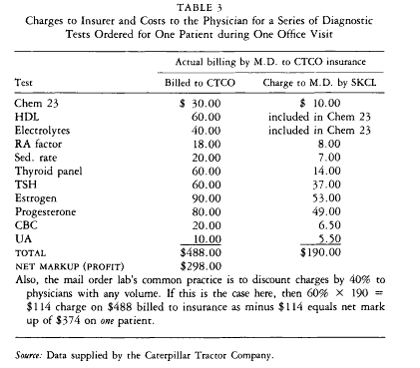

Slide 6
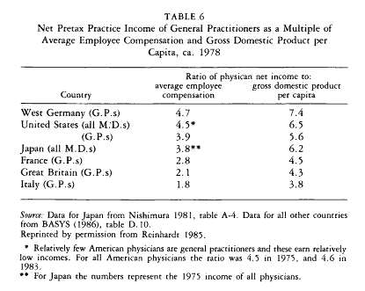

Slide 7
Does competition drive down prices and costs?
Brown, M.L., Kessler, L.G., Reuter, F.G., "Is the Supply of Mammography Machines Outstripping Need and Demand?" Annals of Internal Medicine, October, 1, 1990, 113(7), pp. 547-552. Also contrary to the competitive market model, excess capacity does not lead to price competition.

Slide 8
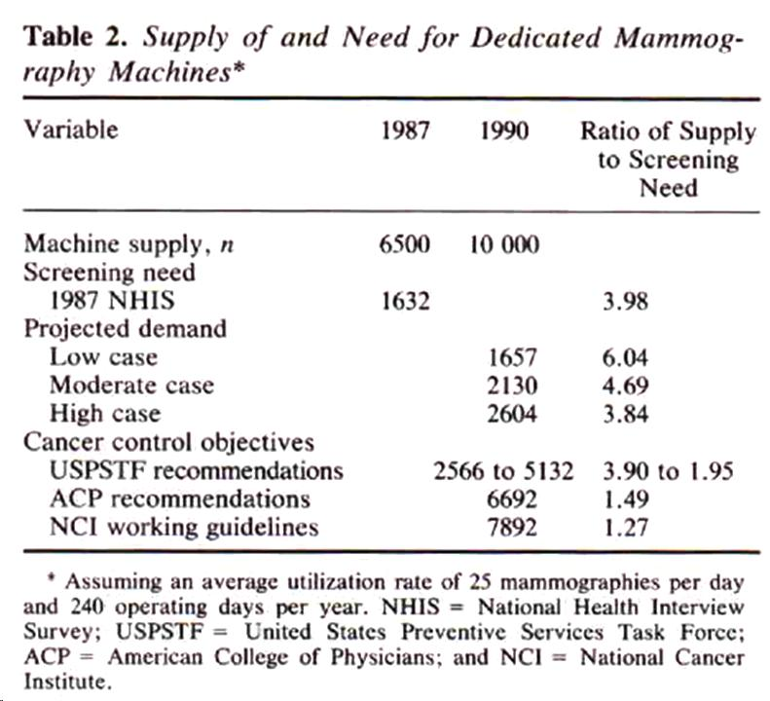

Slide 9
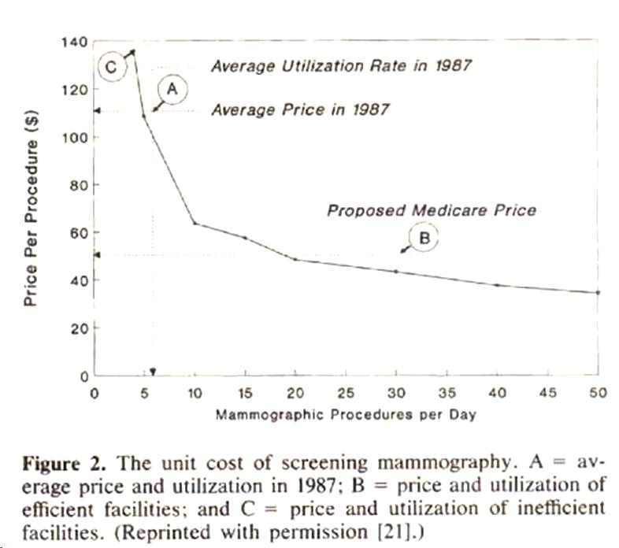

Slide 10
Docs with financial interest ordered more tests
Hillman, B.J., Joseph, C.A., Mabry, M.R., Sunshine, J.H., Kennedy, S.D., Noether, M., "Frequency and Costs of Diagnostic Imaging in Office Practice -- A Comparison of Self-Referring and Radiologist-Referring Physicians," N Engl J Med, Dec. 6, 1990, 323(23), pp. 1604-1608.

Slide 11
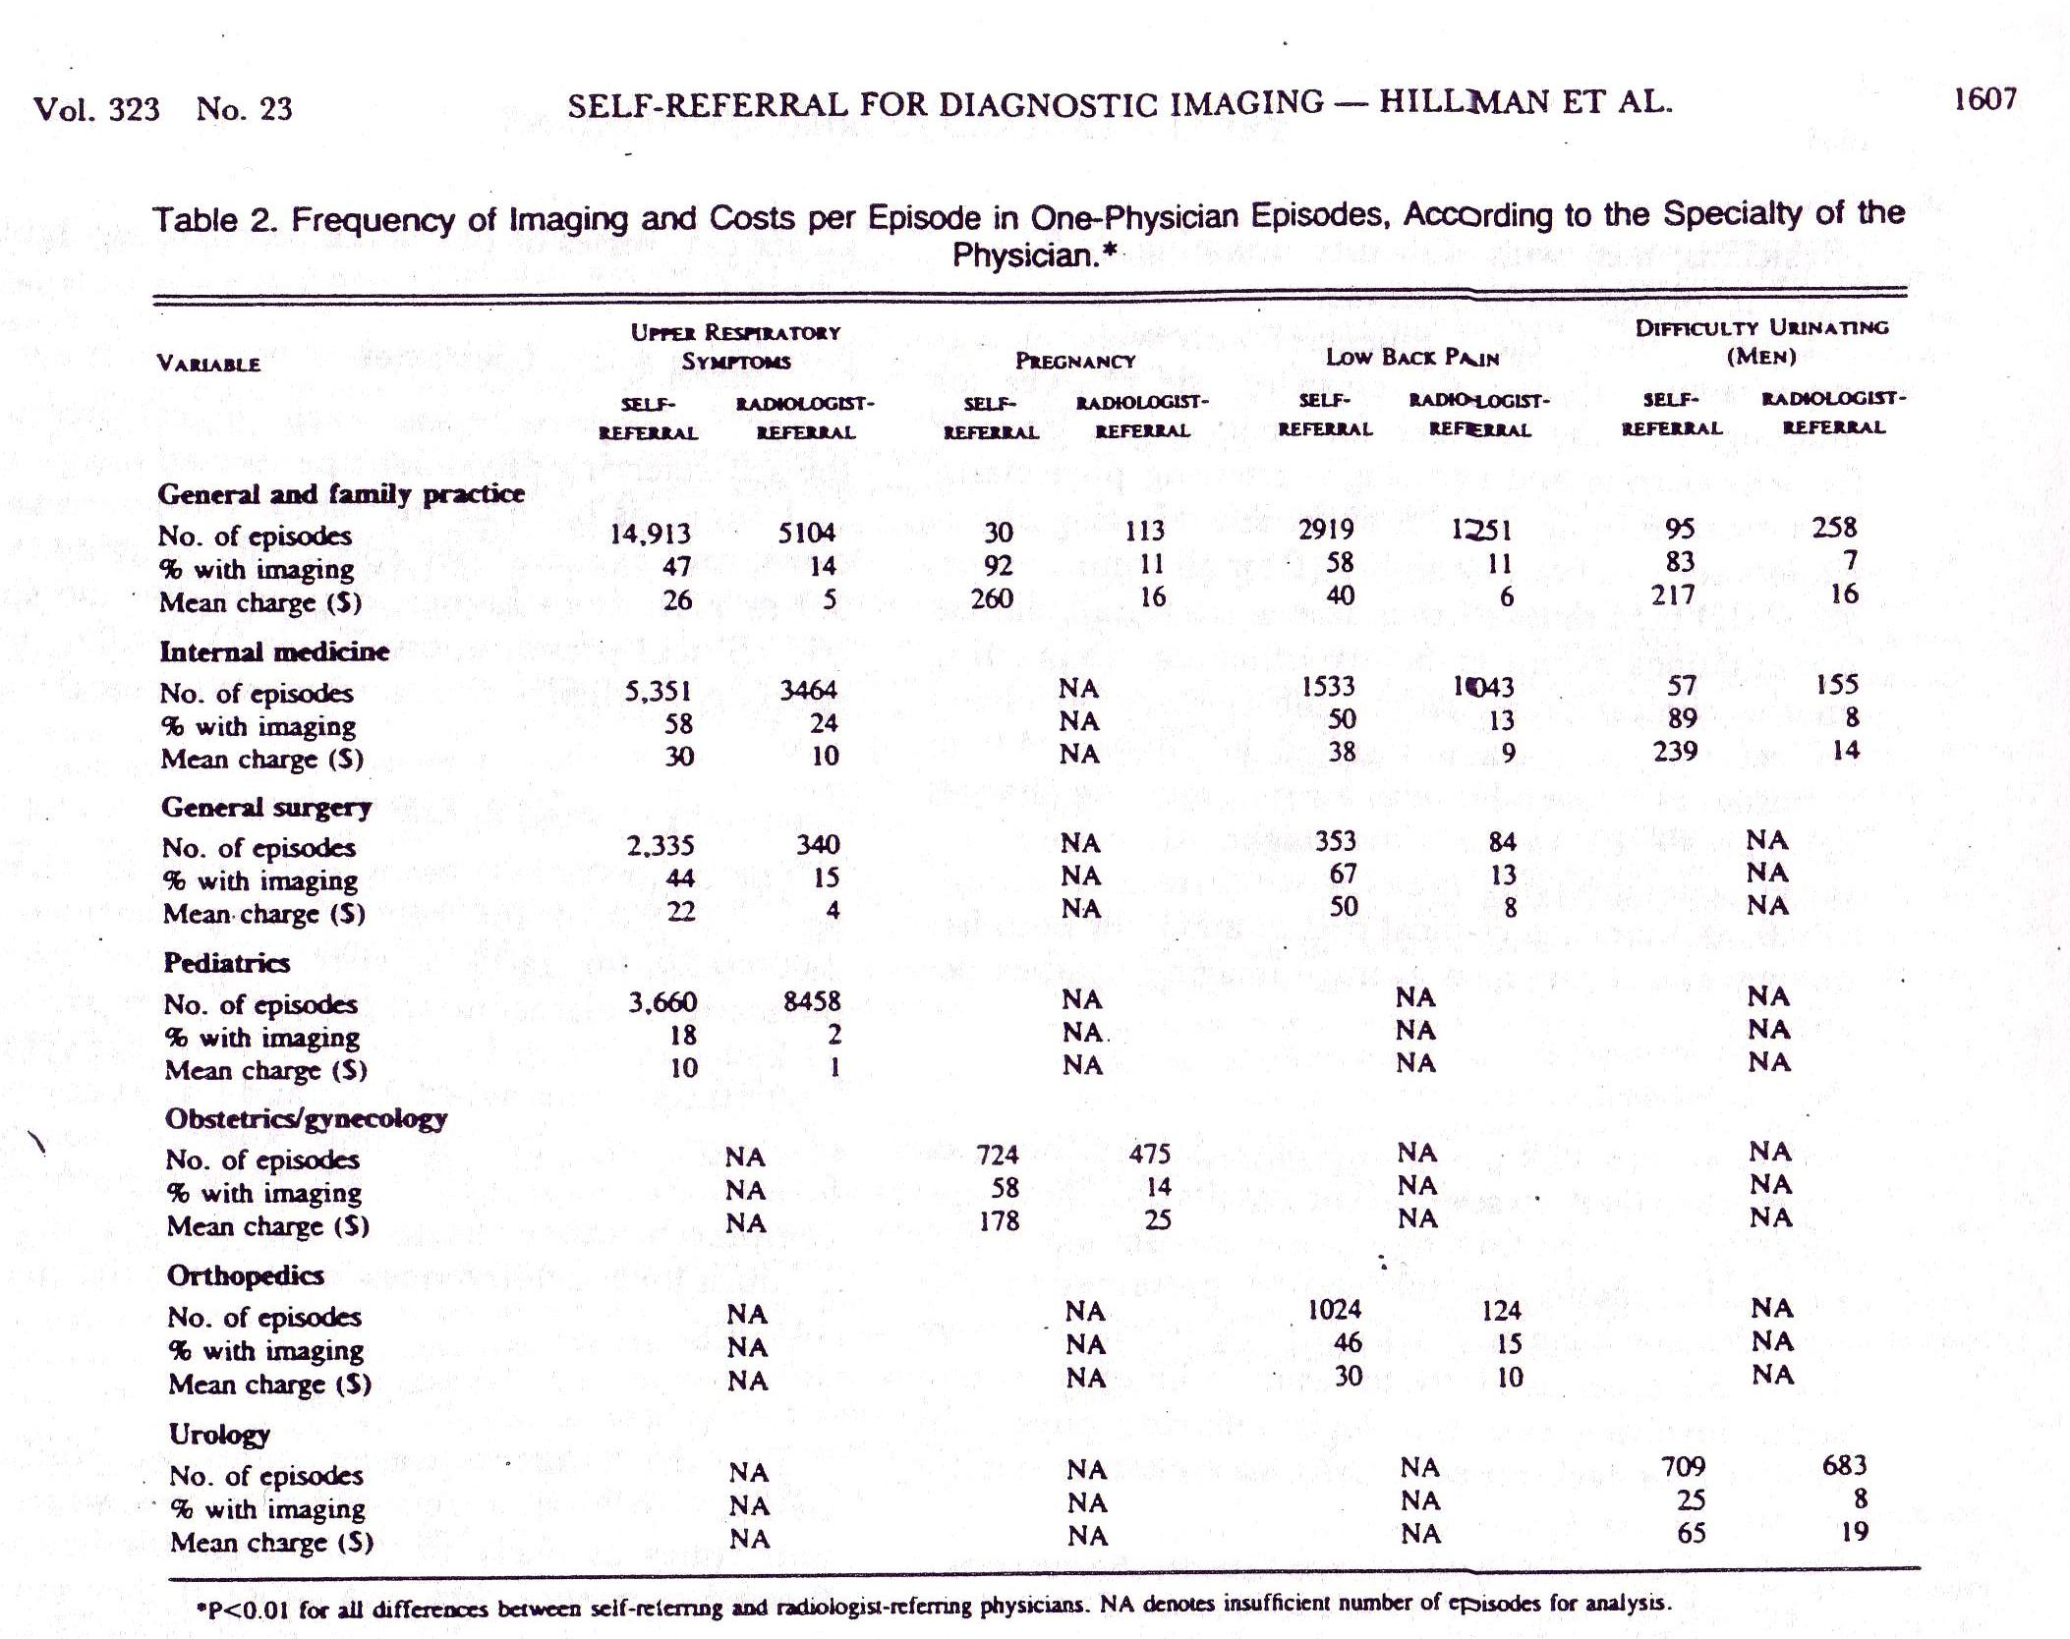

Slide 12
For-profit hospitals did more and charged more
Pattison, R.V., and Katz, H.M., "Investor-Owned and Not-for-Profit Hospitals: A Comparison Based on California Data," N Engl J Med, August 11, 1983, 309, pp. 347-353. More differences with the competitive model: Some providers (for-profit hospitals, in this case) can charge more than other providers for the same services.

Slide 13
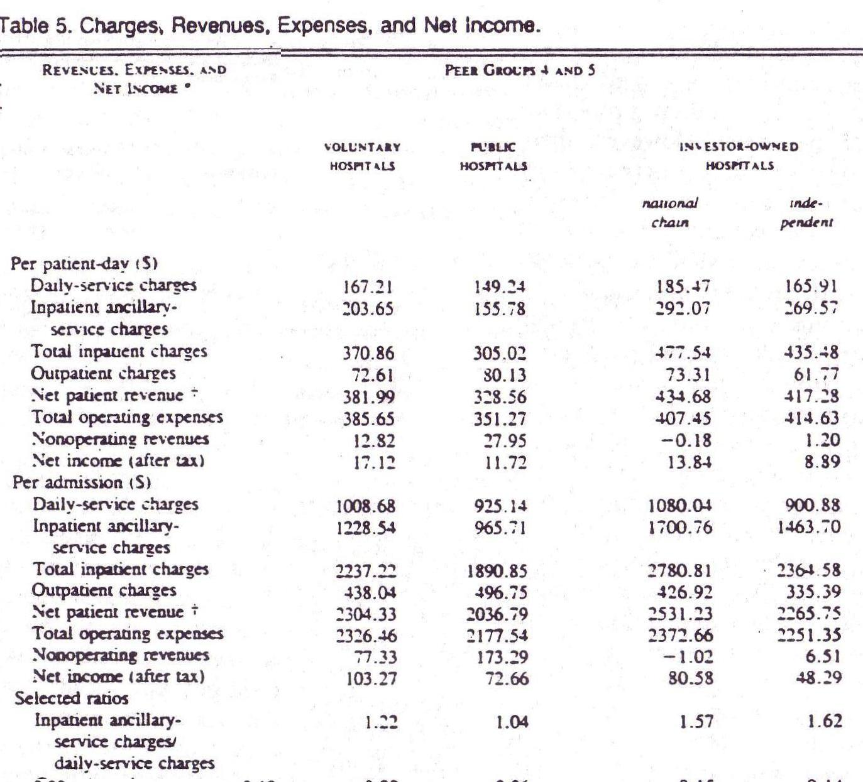

Slide 14
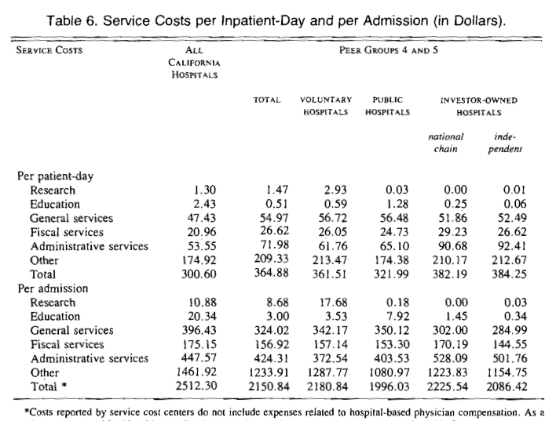

Slide 15
More administrative overhead in for-profit hospitals
Woolhandler, S., Himmelstein, D.U., "Costs of Care and Administration at For-Profit and Other Hospitals in the United States," N Engl J Med, March 13, 1997, 336(11), pp. 769-74.

Slide 16
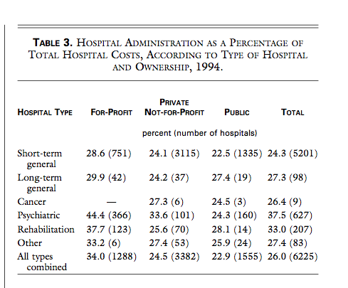

Slide 17
Pricing “chaos”
Reinhardt, Uwe E., "The Pricing Of U.S. Hospital Services: Chaos Behind A Veil Of Secrecy," Health Affairs, January/February 2006; 25(1): 57-69.

Slide 18
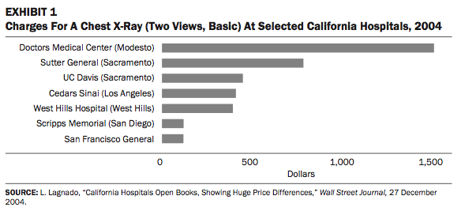
Charges vary by 4x

Slide 19
“… a hospital will submit, for all of its pa- tients, detailed bills based on its chargemaster, even to patients covered by Medicare.
“… in principle, patients can check whether all of the supplies and services listed on the bill were actually delivered.

Slide 20
“… these bills are very lengthy and add up to large totals that do not bear any systematic relationship to the amounts third-party payers actually pay …
“… these actual payments tend to be less than half of the amounts that originally were billed.
“Invoices at chargemaster prices … would yield truly enormous profits if those prices were actually paid.

Slide 21
Payment clearinghouses
Despite HIPAA

Slide 22
Price discrimination structural requirements
High fixed cost relative to total cost
  Some customers must pay more than marginal cost for the enterprise to thrive
Segmented market
  So different customers can be charged different prices

Slide 23
Price discrimination
In each market segment, charge “what the market will bear”
  Raise price so long as demand is inelastic
  or, negotiate price with that segment’s payers
Profit-enhancing or beneficent?
  Both?

Slide 24
What happens if prices change in one segment?
http://economix.blogs.nytimes.com/2009/10/16/is-medicare-raising-prices-for-the-privately-insured/
http://www.gnyha.org/8845/File.aspx
    Looks like Medicare prices lower corresponds with private payer prices higher

Slide 25
Can “consumer-driven” health care – or cost-effectiveness-driven decisions – work if the prices give wrong signals?
“To move from the present, chaotic pricing system toward a … system that could support genuinely consumer-directed health care will be an awesome challenge.
“Yet without major changes in the present chaos, forcing sick and anxious people to shop around blindfolded … mocks the very idea of consumer-directed care.

Slide 26
…and the quantities are chaotic
http://hspm.sph.sc.edu/Courses/Econ/CLASSES/849.regional%20variation.pdf

